Slide 1

Campus Tree Visualizations
Grant Smith, Aaron Dennis, Cindy Brewer
Geography 467

Slide 2
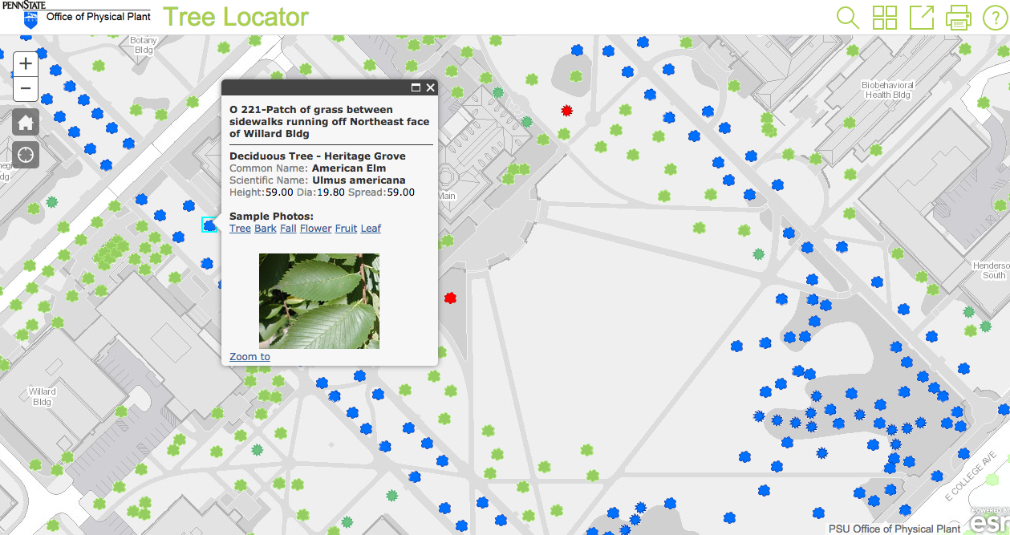
Current Trees at Penn State
PSU Lorax
OPP
Info about height, diameter, spread, type
Separate map from campus map

Slide 3
Objectives of Project
Create 2 trees images
Evergreen and Deciduous
.svg format for Mapbox Studio
Won’t become pixelated when zooming
Use ‘SPREAD’ attribute to create proportional symbols for trees on campus
Make trees symbols semi-transparent
Rest in the background, don’t take away from other map content

Slide 4
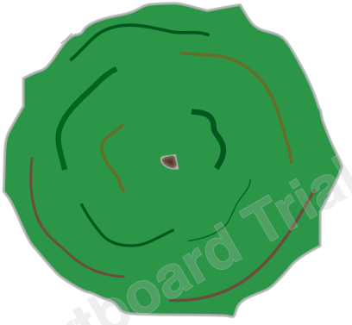

Deciduous
Evergreen

Slide 5
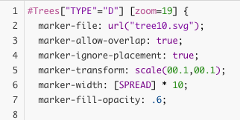
Example Code

Slide 6
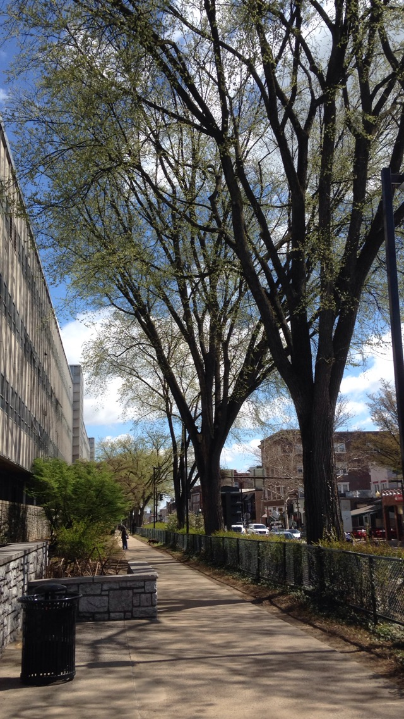
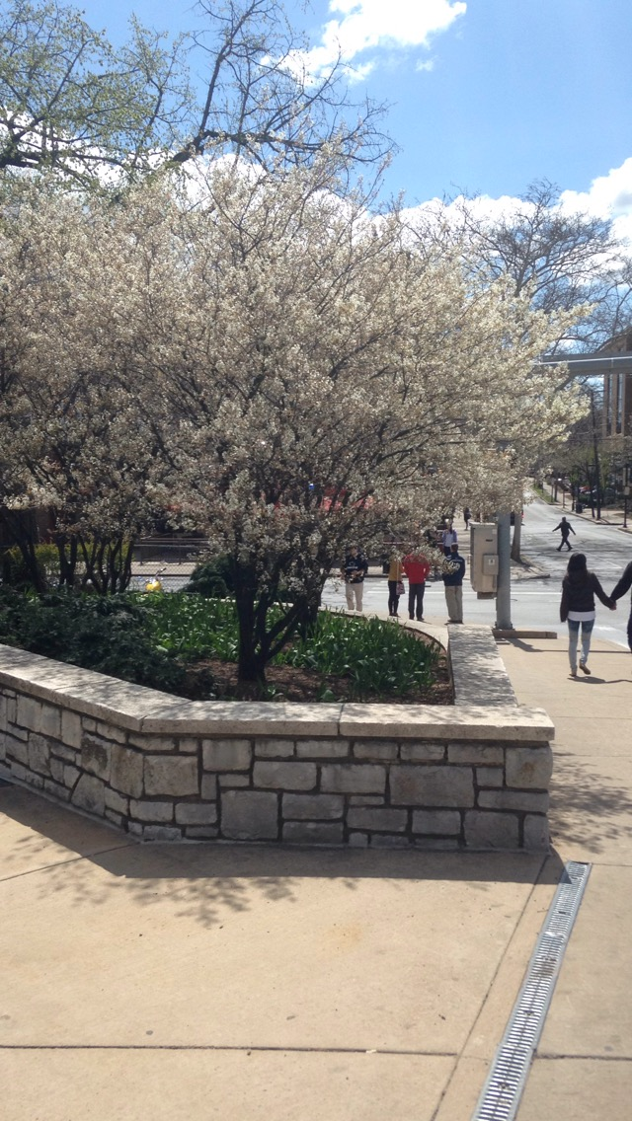
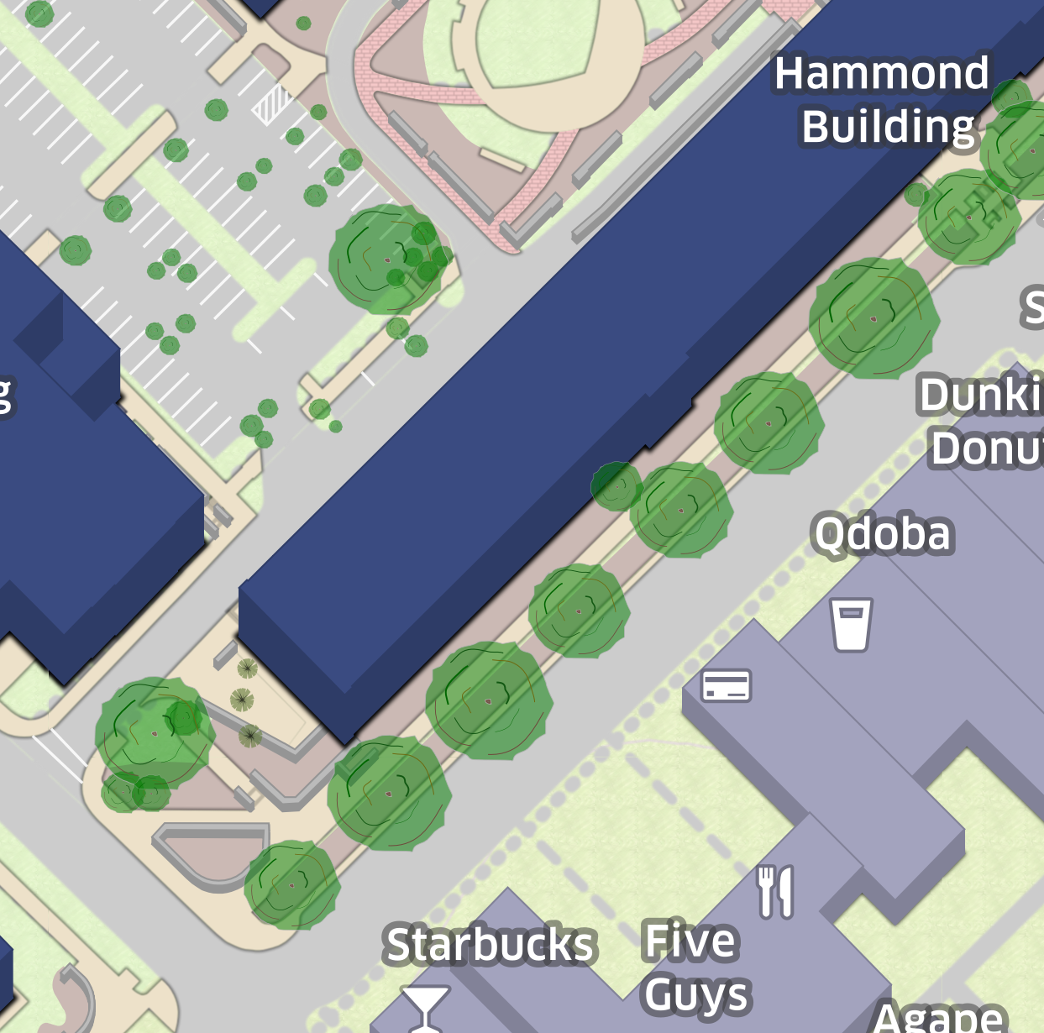
Modeling
Attempted to model spread in Mapbox based off of actual spread of trees on campus

Slide 7
TREE DEMO

Slide 8
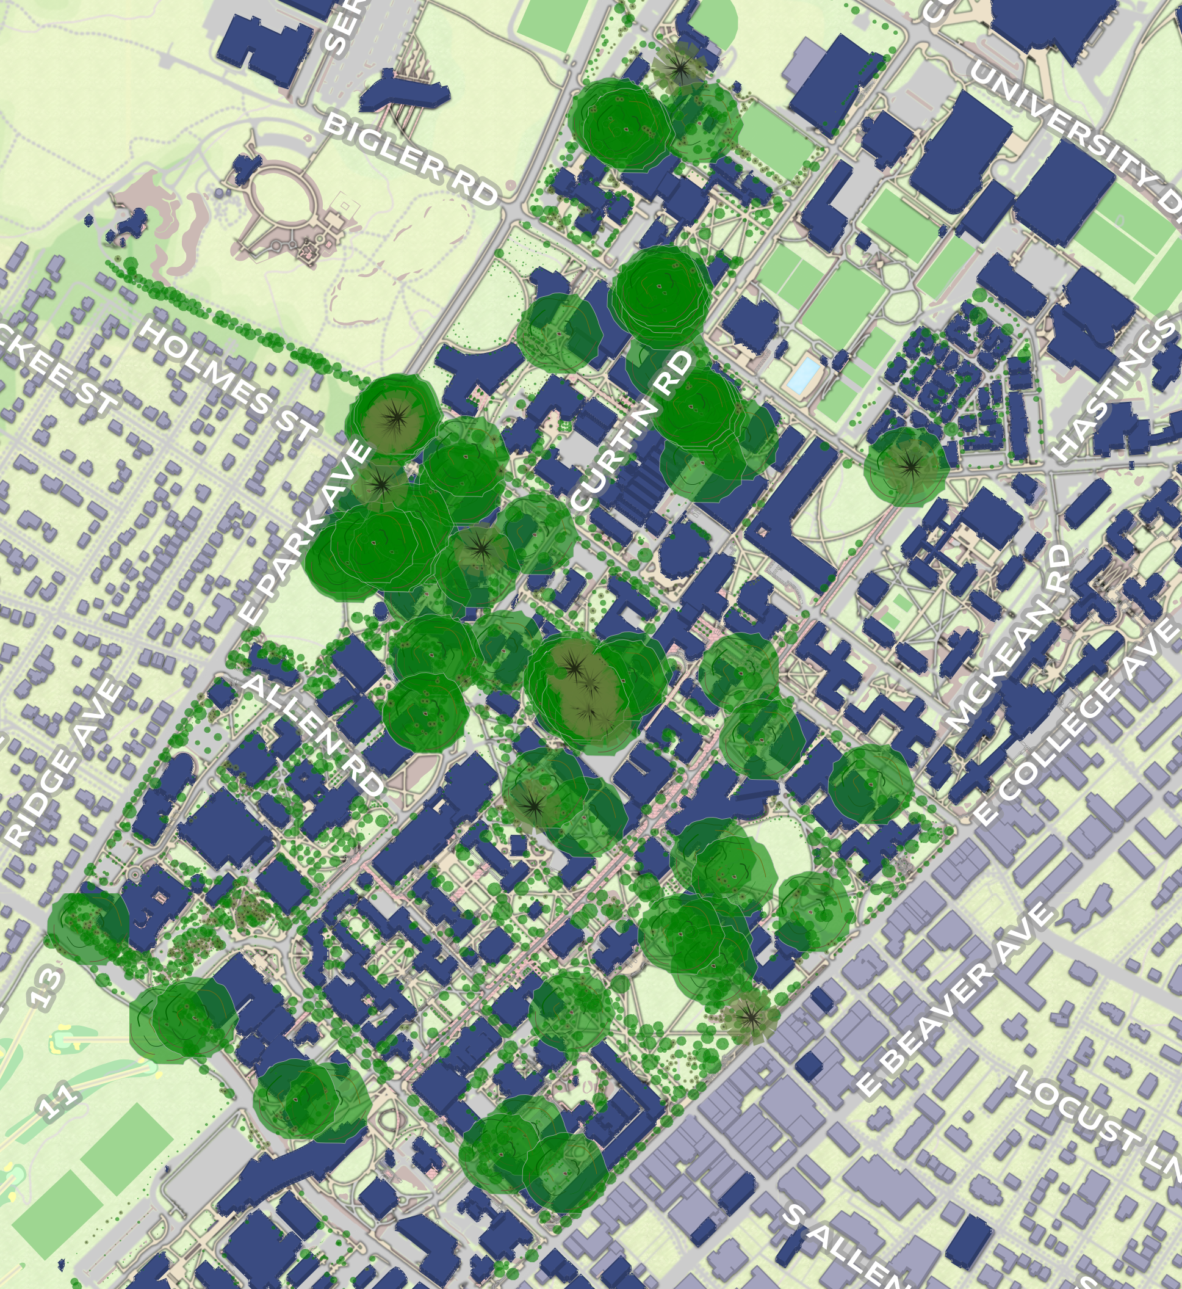
Problem
Not so good
Good

Slide 9
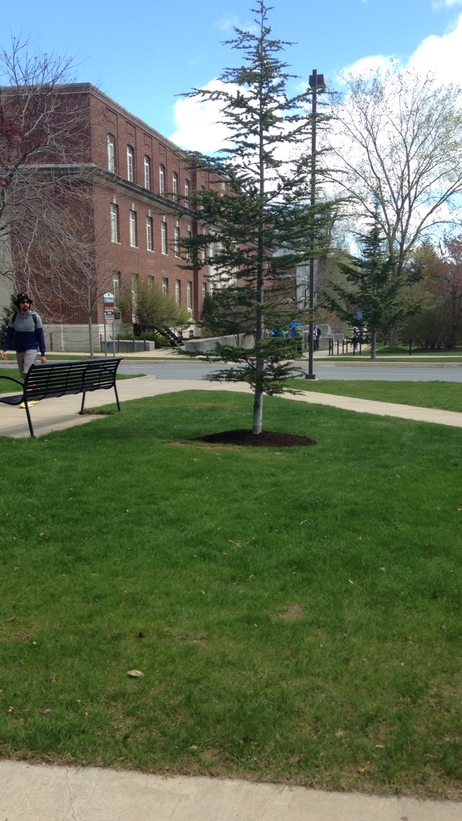
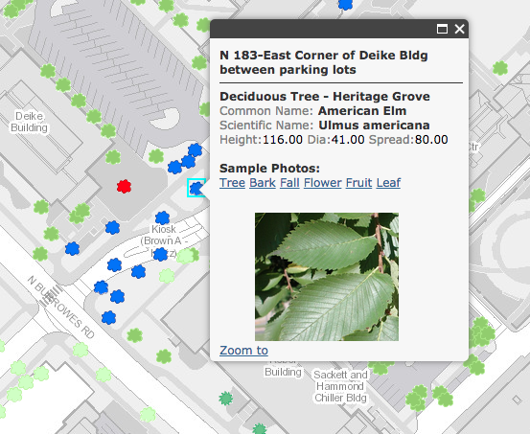
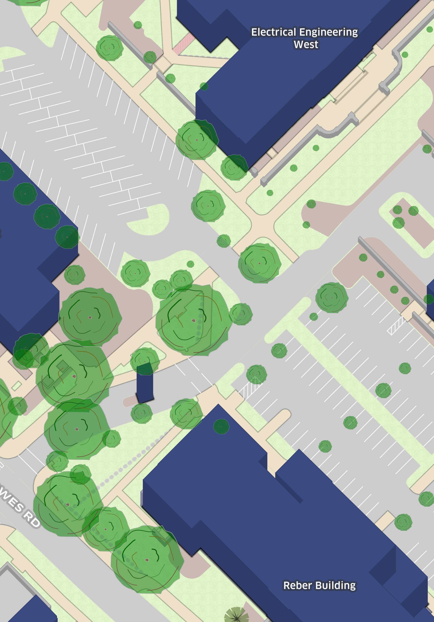
Additional Issues

Slide 10
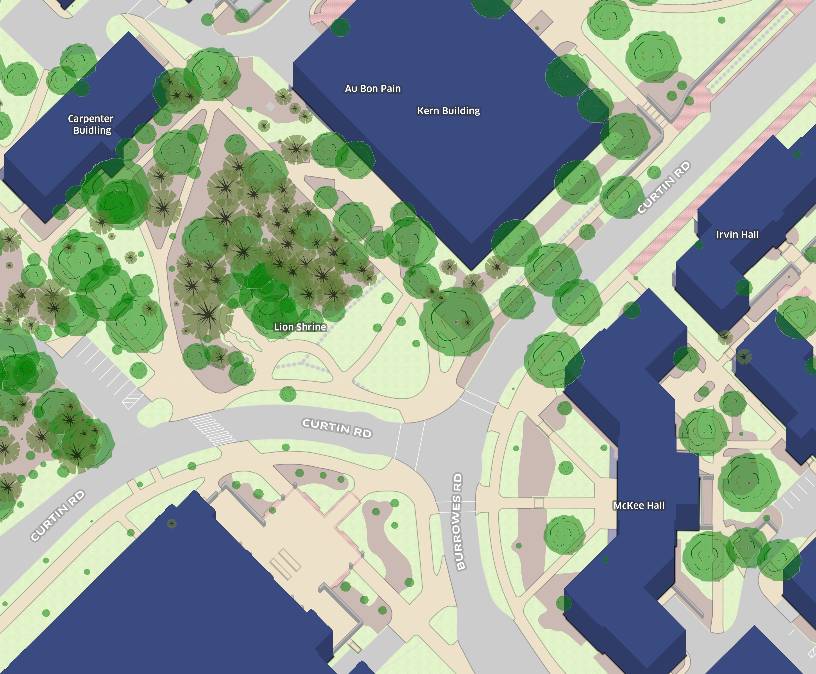

Slide 11
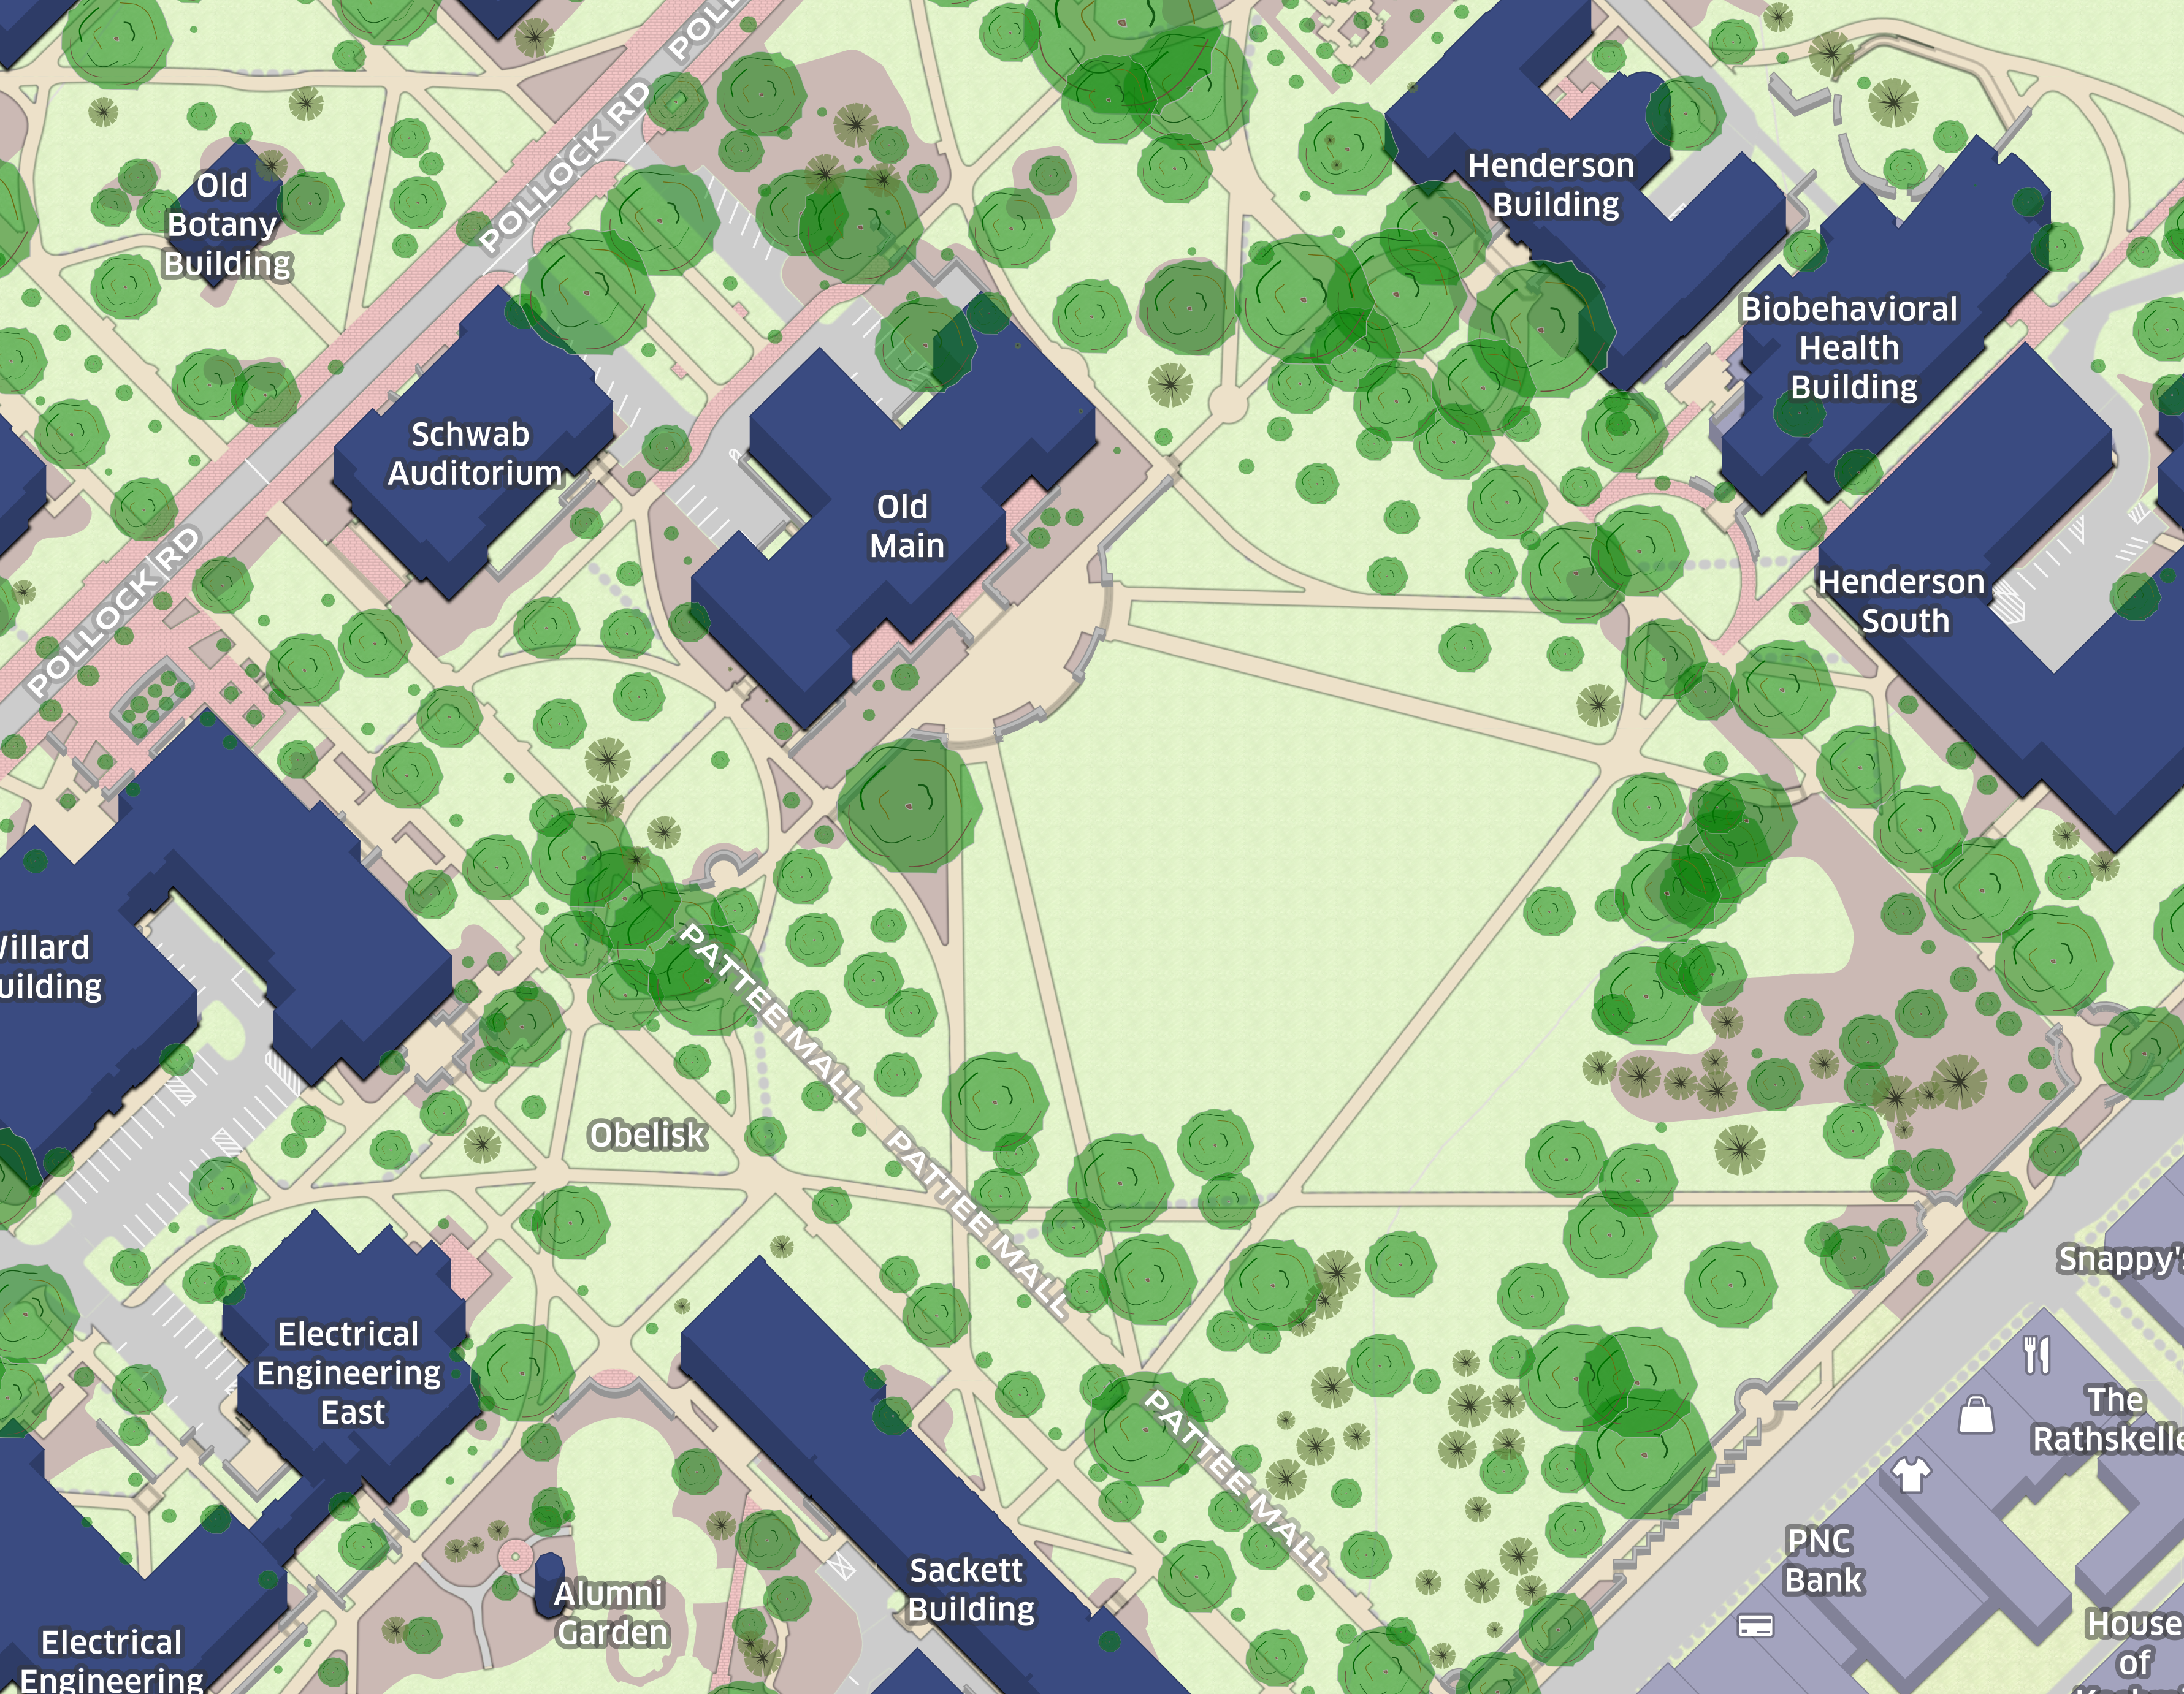

Slide 12
